Slide 1


Department of Artificial Intelligence and Data Science
Developing a Hybrid Model To predict Alzheimer’s Disease
Done By
Prasanna S
221801038
Sukish M
221801053
Guided BY
Mrs M.Thamizharasi AP AI&DS

Slide 2
Problem Statement and Motivation
Alzheimer's disease is a progressive neurodegenerative disorder characterized by cognitive decline, memory loss, and behavioral changes. Early diagnosis is critical for managing the disease, potentially slowing its progression, and improving patients' quality of life. However, diagnosing Alzheimer's disease in its early stages Remain challenging.
Motivation
Develop a model to predict the likelihood of Alzheimer's disease in patients based on MRI data.

Slide 3
Objectives
The objective of this project is to develop an advanced predictive model to accurately predict Alzheimer's disease by integrating MRI imaging data . This aims to enhance diagnostic accuracy and speed by combining these data sources, thus providing a more comprehensive analysis.

Slide 4
Abstract
Alzheimer's disease (AD) is a common brain disorder that severely affects memory and thinking. Early and accurate diagnosis is crucial for managing the disease effectively. Traditional methods, like clinical assessments and MRI scans, are often slow and can miss early signs of AD. Recently, deep learning, especially Convolutional Neural Networks (CNNs), has shown promise in improving the accuracy and speed of diagnosing AD, developing a deep learning model that combines MRI images and clinical datasets to predict Alzheimer's disease more accurately.

Slide 5
Introduction and Overview of the Project.
Alzheimer's disease is a progressive neurological condition that results in significant cognitive deterioration, memory impairment, and notable changes in behavior. Early diagnosis is crucial as it can help in managing the disease more effectively, slowing its progression, and significantly improving the quality of life for patients. However, detecting Alzheimer’s disease in its initial stages poses substantial challenges due to the gradual onset and subtlety of symptoms, which often overlap with normal aging or other cognitive disorders. This project is motivated by the urgent need to improve the accuracy and reliability of early Alzheimer's diagnosis. We aim to develop an advanced deep learning model that predicts the likelihood of Alzheimer's disease by analyzing MRI scans. The project leverages data fusion techniques to integrate various sources of information.

Slide 6
Literature Survey
S.No | Author Name | Paper Title | Description | Jornal | Volume/ Year
1. | Muhammad Syaeka Kadafi | Alzheimer’s prediction via CNN-SVM on chatbot platform with MRI | This research uses AI for Alzheimer's prediction, applying a CNN-SVM model on brain MRI images to classify AD stages with up to 99% accuracy. An integrated chatbot also showed high accuracy, emphasizing AI's potential in early AD detection and healthcare. | (IAES) | 01 Aug 2024
2. | A. Manimuthu | Prediction of Alzheimer’S Disease from Magnetic Resonance Images (MRI) | This study leverages both Machine Learning and Deep Learning to predict Alzheimer's disease using MRI images, with a VGG16-based model achieving 80.8% accuracy. This surpasses other models, marking significant progress in Alzheimer's diagnosis and treatment optimization. | IEEE | 09 Feb 2024

Slide 7
Literature Survey
S.No | Author Name | Paper Title | Description | Jornal | Volume/ Year
3. | Satyanarayana Botsa | A convolutional neural networks approach in MRI image analysis for Alzhei | This study applies various CNN models to MRI scans for detecting Alzheimer's disease, highlighting their potential to improve diagnostic accuracy and efficiency. The research emphasizes the role of AI in advancing early detection and treatment in healthcare. | GSC Online Press | 30 Jul 2024
4. | Gilang Titah Ramadhan | Deep Learning Approach to Predict Alzheimer's Disease through Magnetic Resonance Images | This study uses the VGG-19 CNN architecture to classify Alzheimer's disease from sagittal MRI images, achieving 94% accuracy on the validation set. The approach underscores the potential of deep learning for early diagnosis of Alzheimer's. | IEEE | 17 Jul 2023

Slide 8
Literature Survey
S.No | Author Name | Paper Title | Description | Jornal | Volume/ Year
5. | A. M. El-Assy, Hanan M Amer, H. M. Ibrahim, M. A. Mohamed | A novel CNN architecture for accurate early detection and classification of Alzheimer’s disease using MRI data | An architecture for a convolutional neural network that utilizes magnetic resonance imaging data from the Alzheimer’s disease Neuroimaging Initiative (ADNI) dataset to categorize AD is proposed, demonstrating the efficacy of the network in capturing and discerning relevant features from MRI images, enabling precise classification of AD subtypes and stages. | Dental science reports | 12 Feb 2024
6. | L Sreenivasamurthy | Deep Learning Classification using MRI for Alzheimer’s Disease Detection | A novel 6-layer CNN model is presented for the classification of Alzheimer's disease based on MRI images. The model achieved an accuracy of 98.83%, which is better than other previously proposed CNN-based models. | International Scientific Journal of Engineering and Management | 09 Feb 2024

Slide 9
Existing Sytem
Mini-Mental State Examination (MMSE): A widely used test that assesses cognitive function through a series of questions and tasks. It helps in evaluating memory, attention, language, and orientation.
PET Scans: Can detect amyloid plaques and tau tangles, which are characteristic of Alzheimer's disease. While useful, PET scans are expensive and less accessible.
Computed Tomography (CT): Provides structural imaging of the brain but is less sensitive than MRI and PET in detecting early changes associated with Alzheimer’s disease

Slide 10
Drawbacks of Existing System
Mini-Mental State Examination (MMSE):
Subjective Results: Results can vary based on the examiner and patient’s emotional state.
Cultural Bias: Performance may differ due to cultural and educational backgrounds.
Limited Assessment: Focuses on specific areas, potentially missing subtle cognitive changes.
PET Scans:
High Cost: Expensive, limiting accessibility for many patients.
Accessibility Issues: Limited availability in some regions may delay diagnosis.
Radiation Exposure: Involves radioactive tracers, raising safety concerns.
Computed Tomography (CT):
Lower Sensitivity: Less effective at detecting early Alzheimer’s changes.
Lower Resolution: Provides less detailed images compared to MRI and PET.
Limited Insight: Mainly shows structural changes, lacking biochemical information.

Slide 11
Proposed System
Entorhinal Cortex-Based Image Processing:
The system processes MRI scans focusing on the entorhinal cortex for early Alzheimer’s detection. Using OpenCV, it enhances the isolated regions for segmentation and further analysis.
U-Net for Segmentation and SE-ResNet for Feature Extraction:
U-Net segments the entorhinal cortex, followed by SE-ResNet, which extracts critical features using attention mechanisms.
Dense Neural Network for Classification:
After feature extraction, the system uses a fully connected Dense Neural Network for classification. This network processes the extracted features and predicts Alzheimer’s or healthy outcomes.

Slide 12
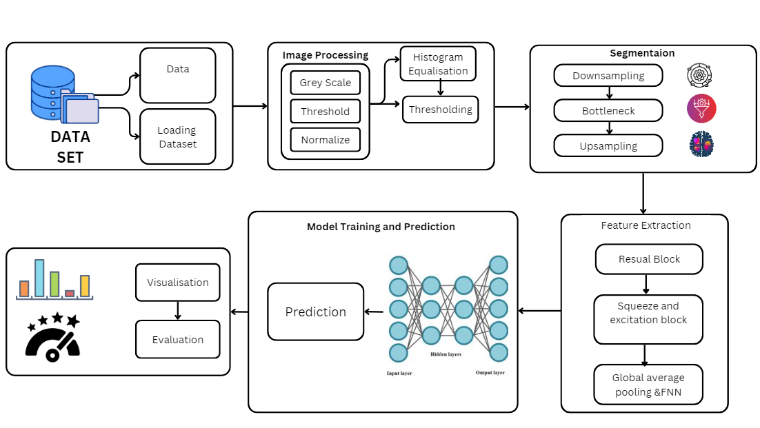
System Architecture

Slide 13
Methodology
Segmentation (U-Net): Isolating regions of interest like the entorhinal cortex.
Feature Extraction (SE-ResNet): Focus on important feature channels and using a pretrained SE-ResNet
model.
Classification (Dense Neural Network): Binary classification of the extracted features into Alzheimer’s
or healthy.
Data Preprocessing: Grayscale conversion, thresholding, normalization, filtering, and augmentation.
Model Training and Evaluation: Using loss functions, regularization, and performance metrics like
accuracy and AUC-ROC.
Inference: Pipeline for predicting Alzheimer’s from unseen MRI images and interpreting results for
clinical use

Slide 14
Methodology
Data Preprocessing Methodology:
Grayscale Conversion: MRI images are converted to grayscale to reduce the complexity of the image and make it easier for the model to process.
Thresholding: A technique to enhance the contrast between brain structures, especially to distinguish the region of interest.
Normalization: This ensures that all pixel values are scaled to a standard range (often between 0 and 1), helping the model converge faster during training.
Segmentation Methodology (U-Net):
U-Net Architecture: This deep learning model is designed specifically for biomedical image segmentation.
Region of Interest (ROI) Segmentation: U-Net is used to segment the entorhinal cortex or other relevant brain regions. The goal is to isolate the part of the brain most affected by Alzheimer’s
Downsampling & Upsampling: The U-Net architecture consists of a contracting path (for feature extraction) and an expansive path (to localize and accurately segment the regions of interest).
Skip Connections: These connections between the contracting and expansive paths ensure that spatial information is preserved throughout the segmentation process.

Slide 15
Methodology
Feature Extraction Methodology (SE-ResNet):
Squeeze and excitation resnet (SE-ResNet): SE-ResNet is a variation of ResNet that incorporates attention mechanisms to focus on the most important channels in the feature maps.
Attention Mechanism (Squeeze-and-Excitation Blocks): These blocks help the network identify the most relevant parts of the segmented MRI images by reweighting the feature channels based on their importance.
Pretrained Model: SE-ResNet utilizes weights pretrained on ImageNet, which allows the model to leverage prior knowledge while being fine-tuned on MRI images for Alzheimer's detection.
Multi-scale Feature Extraction: SE-ResNet captures features at multiple scales, helping detect subtle changes in the brain structure associated with Alzheimer’s disease.
Classification Methodology:
Dense Neural Network: After feature extraction, the SE-ResNet output is passed through fully connected (dense) layers.
Global Average Pooling (GAP): Reduces the spatial dimensions of the feature maps from SE-ResNet before passing the features into the dense layers.
Binary Classification: The dense network is trained to classify whether the extracted features indicate Alzheimer’s disease or not. The output layer uses a sigmoid activation function to provide a probability score for Alzheimer’s diagnosis.
Regularization: Dropout layers are used in the dense network to prevent overfitting during training.

Slide 16
Methodology
Model Training and Evaluation Methodology:
Training Process: The model is trained using backpropagation and gradient descent, typically optimized using the Adam optimizer, which adjusts the learning rate dynamically during training.
Loss Function: A binary cross-entropy loss function is used, as this is a binary classification task.
Performance Metrics:
Accuracy: Measures the percentage of correct predictions.
Precision, Recall, F1-score: These metrics help evaluate the model’s performance in detecting Alzheimer’s disease, especially in handling class imbalances.
AUC-ROC Curve: Used to assess the performance of the binary classifier, particularly in separating Alzheimer’s patients from healthy subjects.
Visualization of Results: Techniques such as confusion matrices and AUC curves are used to visualize the model's performance.
Inference Methodology:
Prediction Pipeline: After training, the pipeline processes unseen MRI images by passing them through the preprocessing steps, segmentation with U-Net, feature extraction with SE-ResNet, and classification with the dense network.
Model Interpretability: Techniques like Grad-CAM (Gradient-weighted Class Activation Mapping) can be used to highlight the areas of the MRI that contributed most to the model’s prediction, helping interpret the output for medical experts.

Slide 17
Modules
Data Preprocessing Module
Feature Extraction and Segmentation Module
Model Training Module
Visualization and Evaluation Module

Slide 18
Data Preprocessing Module
Loading and Normalizing Images: MRI scans of the hippocampus are loaded from directories and normalized (dividing pixel values by 255) to fit within a standard range.
Image Transformation: Images are converted to appropriate formats (e.g., RGB) and resized if necessary. Left and right hippocampus regions are merged for consistent input.
Algorithm Steps:
Load MRI image.
Convert image to grayscale.
Apply thresholding to segment the enhorhinal cortex.
Apply edge detection (Canny) to enhance boundaries.
Skeletonize the image for simplified analysis.

Slide 19
Data Preprocessing Module - Techniques
Grayscale Conversion: MRI scans are typically multi-channel images. Converting them to grayscale reduces complexity and focuses solely on intensity-based variations, which are vital for identifying structural changes in brain regions like the entorhinal cortex.
Normalization: It scales the pixel intensity values to a standard range, often between 0 and 1. This eliminates the impact of varying lighting conditions or scanner differences across datasets.

Slide 20
Data Preprocessing Module - Techniques
Thresholding: It is applied to differentiate the region of interest (ROI) from the background. This helps isolate the entorhinal cortex from the surrounding brain structures.
Histogram Equalization: To enhance the contrast of the images, histogram equalization redistributes pixel intensities for better visualization of anatomical structures.
Resizing and Cropping: MRI images are resized and cropped to a consistent dimension, ensuring uniform input to the deep learning models. This step reduces computational overhead and standardizes the dataset.

Slide 21
Data Preprocessing Module -Alogrithm
1.Input: Start with raw MRI datasets
2.Format Conversion:Convert MRI scans to standard formats(e.g., JPEG/PNG).
3.Resampling: Resize images to a consistent resolution (e.g., 256x256 pixels).
4.Normalization: Normalize pixel intensities for uniform contrast.
5.Skull Stripping: Remove non-brain elements like skull and scalp.
6.Bias Field Correction: Correct intensity inhomogeneities for improved clarity.
7.Segmentation Preparation: Use thresholding and morphology to isolate the entorhinal cortex.
8.Output: Produce a preprocessed dataset ready for feature extraction.

Slide 22
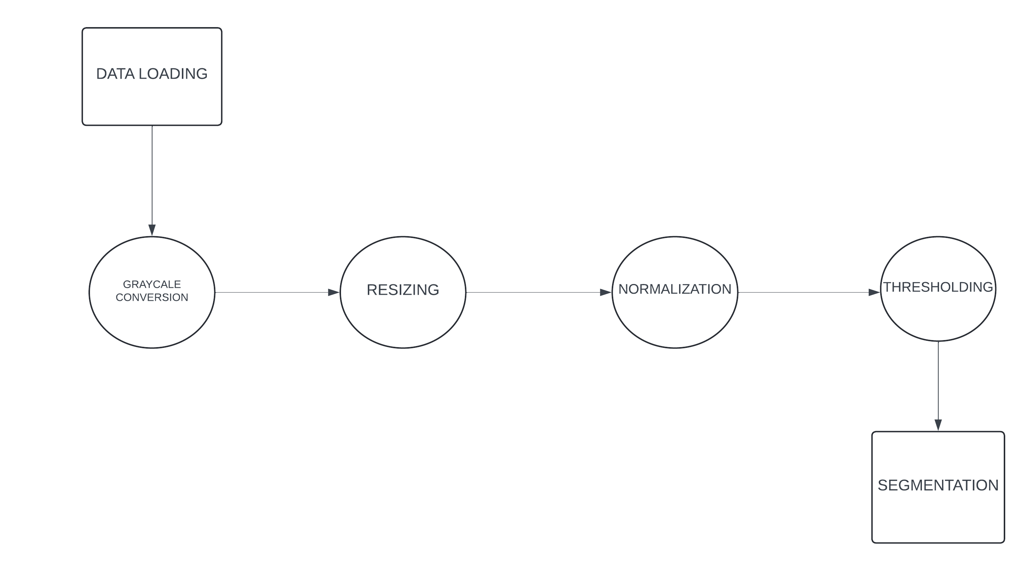
Data Preprocessing Module DFD

Slide 23
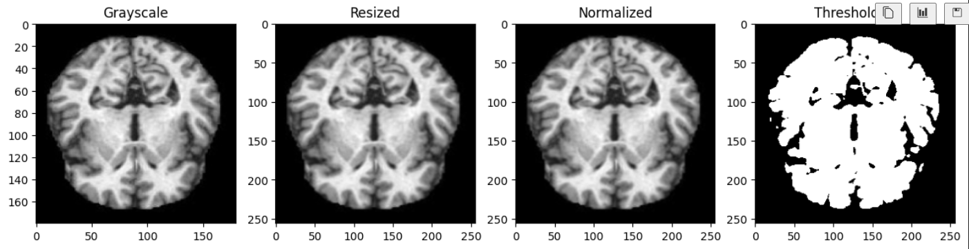
Data Preprocessing Module Output

Slide 24
Feature extraction and Segmentation Module
Architecture: The section of the model uses convolutional layers to extract relevant features from the input images. Convolutional layers capture spatial hierarchies, focusing on important areas like enhorhinal cortex structure changes.
Segmentation : If the model is designed for segmentation, it segments the image to highlight particular areas of interest (e.g., enhorhinal cortex).
Algorithm Steps:
Use Hessian matrix for feature extraction from enhorhinal cortex regions.
Perform additional morphological operations to highlight abnormalities.

Slide 25
Feature extraction Module - Techniques
Residual Learning: Uses residual connections to preserve essential features across network layers.
Squeeze-and-Excitation (SE) Blocks: Highlights informative channels via adaptive recalibration.
Global Average Pooling: Summarizes spatial information into a compact feature vector.
Convolutional Layers: Captures spatial patterns and textures for detailed analysis.

Slide 26
Segmentation Module - Techniques
Encoder-Decoder Architecture: Captures high-level context and reconstructs spatial details.
Skip Connections: Combines features from encoder and decoder for precise localization.
Downsampling: Reduces spatial dimensions while extracting key features.
Upsampling: Reconstructs the segmented mask to original resolution.

Slide 27
Feature Extraction Module - Algorithm
Input Features: Receive segmented entorhinal cortex images from the segmentation module.
Convolutional Layers: Extract spatial patterns and structural changes in the cortex.
Residual Learning: Add input features to the learned features for efficient gradient flow.
Squeeze-and-Excitation Blocks: Recalibrate channel-wise feature importance adaptively.
Global Average Pooling: Reduce spatial dimensions into a compact feature vector for classification.

Slide 28
Segmentation Module - Algorithm
Input MRI Image: Start with preprocessed MRI scans.
Encoder Path: Apply convolutions and downsampling to extract high-level features.
Bottleneck Layer: Capture global context from the encoder’s output.
Decoder Path: Upsample and combine features using skip connections from the encoder.
Output Mask: Generate a binary segmentation mask highlighting the entorhinal cortex.

Slide 29
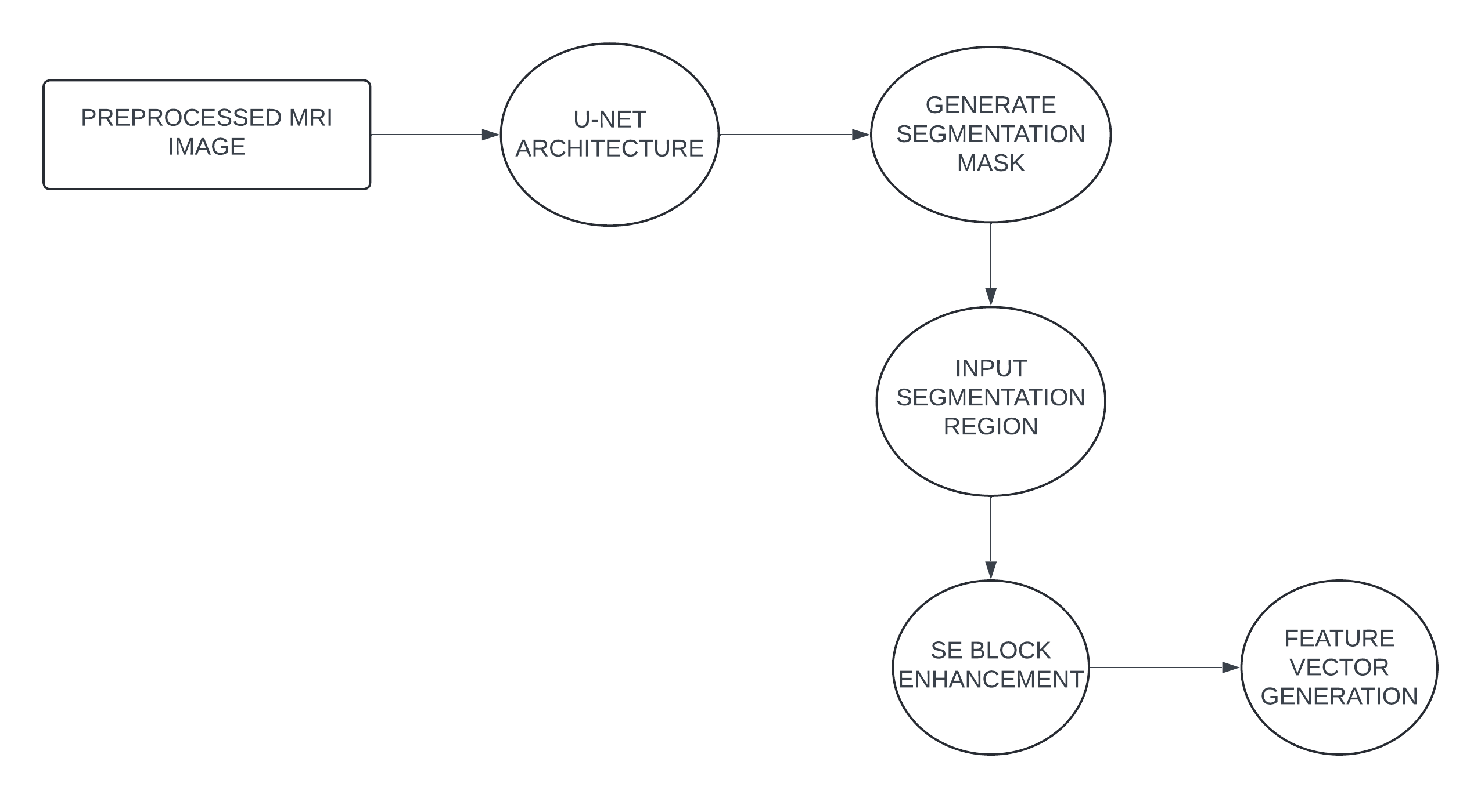
Feature extraction and Segmentation Module DFD

Slide 30
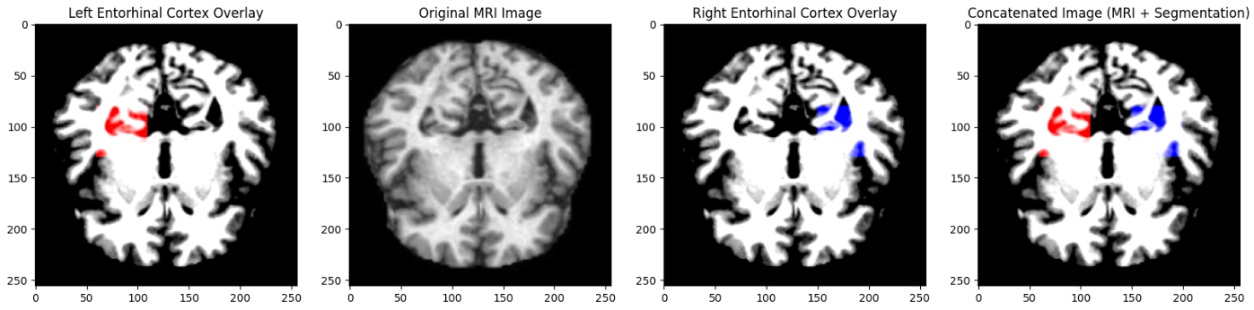
Feature extraction and Segmentation Module Output

Slide 31
Model Training Module
Training: It is trained for a specified number of epochs, learning how to compress and then reconstruct images.
Fine-Tuning Hyperparameters: During training, hyperparameters such as learning rate, batch size, and number of epochs are adjusted to optimize the model’s performance.
Evaluation During Training: Loss and other metrics like mean squared error (MSE) are monitored throughout training to track the model’s progress.
Algorithm Steps:
Train the Autoencoder on processed images.
Generate predictions for test MRI images.

Slide 32
Model Training Module - Techniques
Loss Function: Use binary cross-entropy to optimize classification predictions.
Optimizer: Employ Adam optimizer for faster convergence and adaptive learning rates.
Batch Normalization: Normalize intermediate layer outputs to stabilize and accelerate training.
Early Stopping: Stop training when validation performance stops improving to prevent overfitting.
Learning Rate Scheduling: Adjust learning rates dynamically during training for better performance.

Slide 33
Model Training Module - Algorithm
Initialize Parameters: Set initial weights, learning rate, batch size, and epochs.
Split Dataset: Divide the dataset into training, validation, and testing subsets.
Load Model: Initialize the hybrid model (U-Net for segmentation, SE-ResNet for feature extraction, and Dense network for classification).
Compile Model: Define the loss function (binary cross-entropy) and optimizer (Adam).
Train Model: Iterate through epochs:
a. Shuffle and batch the training dataset.
b. Perform forward pass and compute predictions.
c. Calculate loss using the loss function.
d. Backpropagate gradients and update weights using the optimizer.

Slide 34
Model Training Module - Algorithm
Validate Performance: Evaluate model performance on the validation set after each epoch.
Apply Early Stopping: Stop training if validation performance does not improve for a predefined number of epochs.
Test Model: Evaluate the trained model on the test dataset to measure accuracy and other metrics.
Save Model: Save the trained model for inference and further use.
Output: Generate performance metrics and visualizations for model evaluation.

Slide 35
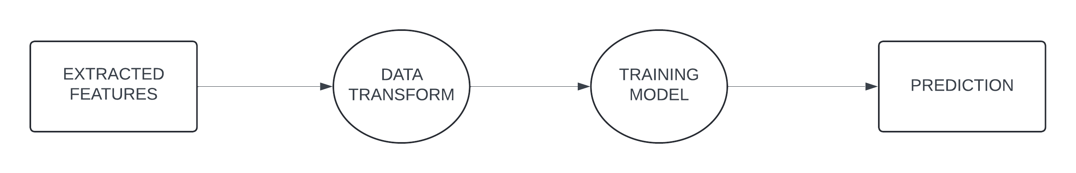
Model Training Module DFD

Slide 36
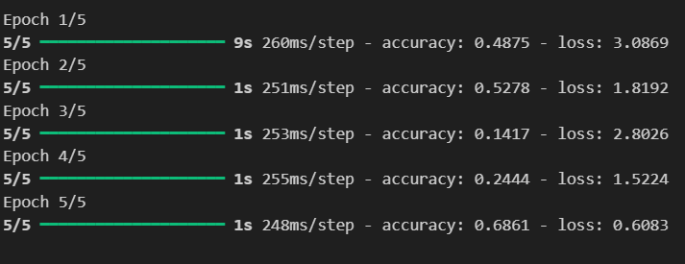
Model Training Module Output

Slide 37
Visualisation and Evaluation Module
Visualization of Original vs. Predicted Images: Using matplotlib, the module plots the original enhorhinal cortex images alongside the model’s reconstructed images, providing insight into how well the model has learned.
Performance Metrics: Evaluation metrics like accuracy, MSE, and confusion matrix are used to quantify the model’s effectiveness in reconstructing and predicting Alzheimer’s-affected images.
Algorithm Steps:
Compare predicted enhorhinal cortex regions with ground truth and visualise.
Evaluate the model on certain metrics like mse, f1 score

Slide 38
Visualisation and Evaluation Module - Techniques
Confusion Matrix: Visualize true positives, true negatives, false positives, and false negatives.
ROC Curve: Evaluate model performance with true positive and false positive rates.
Grad-CAM: Highlight regions of the entorhinal cortex influencing predictions.
Precision-Recall Curve: Analyze trade-offs between precision and recall.
Accuracy and Loss Plots: Monitor training and validation performance over epochs.

Slide 39
Visualisation and Evaluation Module - Algorithm
Generate Predictions: Use the trained model to make predictions on the test dataset.
Compute Metrics: Calculate accuracy, precision, recall, F1 score, and ROC-AUC for evaluation.
Plot Confusion Matrix: Visualize the model's classification performance with a confusion matrix.
Plot ROC Curve: Generate and plot the ROC curve to assess model's sensitivity and specificity.
Apply Grad-CAM: Use Grad-CAM to visualize and highlight important brain regions influencing predictions.
Plot Loss and Accuracy: Visualize training and validation loss and accuracy over epochs to detect overfitting.
Generate Final Report: Summarize evaluation results and visualize performance metrics for reporting.

Slide 40
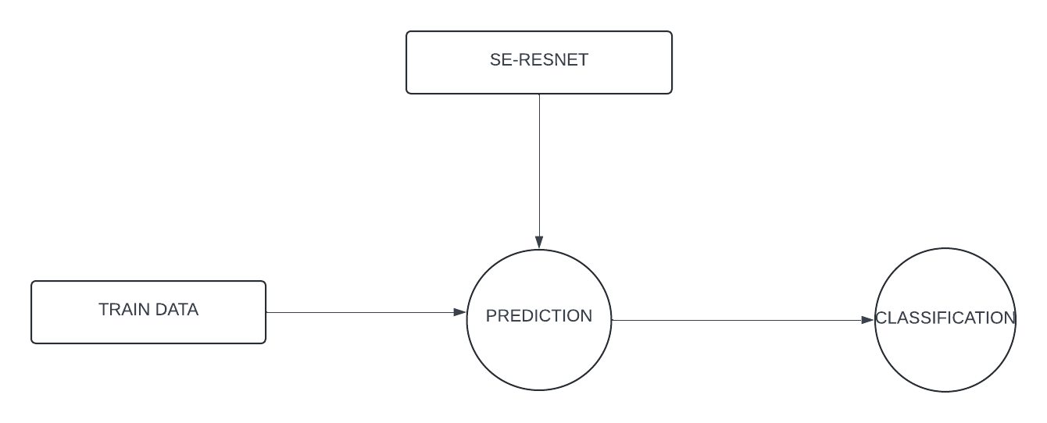
Visualisation and Evaluation Module DFD

Slide 41
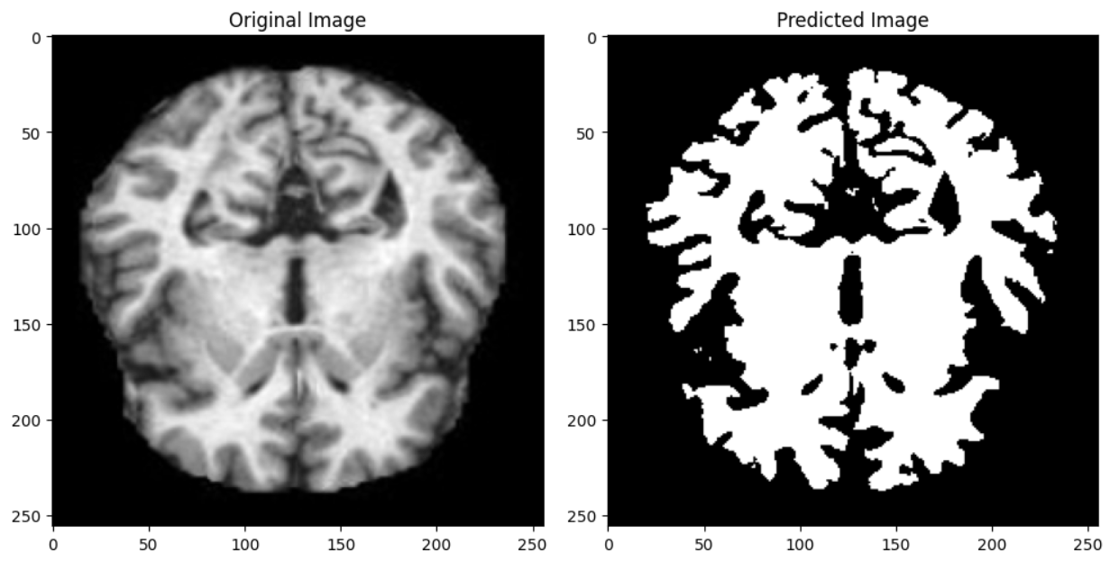
Visualisation and Evaluation Module Output

Slide 42
Result and Discussion
PERFORMANCE COMPARISON
The bar chart compares different models (U-Net + SE-ResNet + Dense, ResNet50, DenseNet, and VGG16) on metrics like accuracy, precision, recall, and F1-score.U-Net + SE-ResNet + Dense achieves the highest accuracy (0.90) and recall (1.00), which indicates strong overall performance, especially in identifying true positives. This makes it suitable for accurate Alzheimer's classification.Precision for most models (except DenseNet, which is lower at 0.67) is around 0.80, suggesting that the models generally avoid false positives.F1-score values are also close to 0.80 for all models except DenseNet, where it drops to 0.73. This shows a balance of precision and recall across models, with U-Net + SE-ResNet + Dense leading.

Slide 43
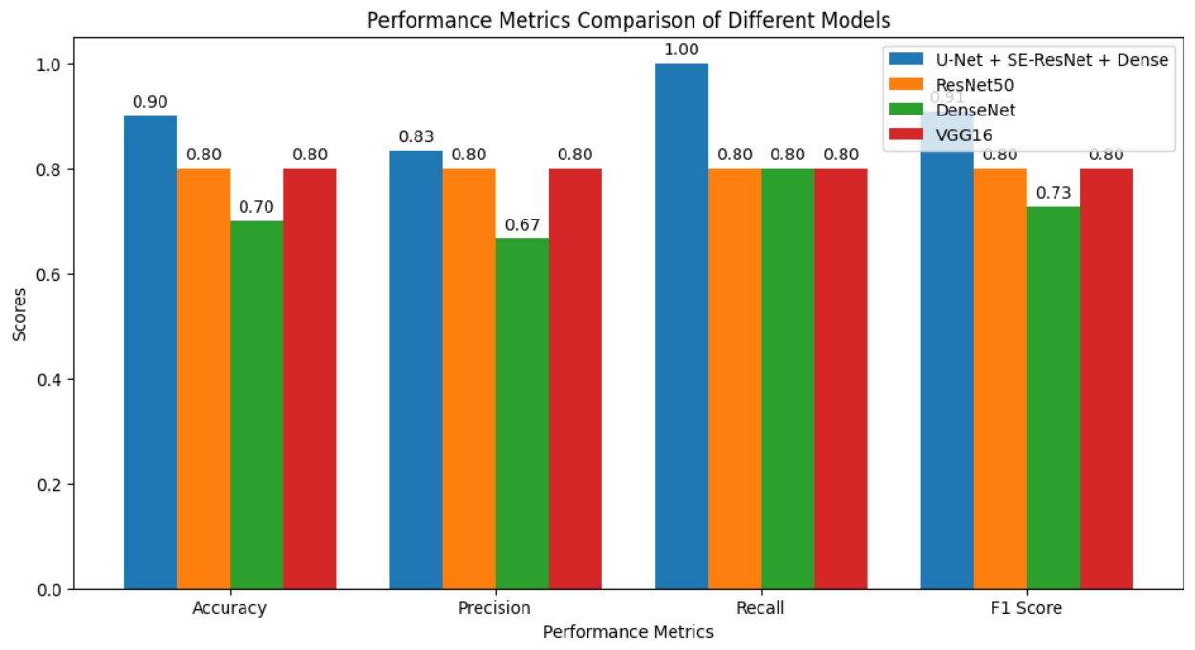
Result and Discussion.
PERFORMANCE COMPARISON

Slide 44
Result and Discussion
Reconstruction Error Distribution
The shows the reconstruction error distribution for the models, useful for evaluating models focused on anomaly detection.U-Net + SE-ResNet + Dense has a wider distribution with higher reconstruction errors, likely making it more sensitive to structural abnormalities in brain scans (like hippocampal shrinkage associated with Alzheimer's).Other models (DenseNet, ResNet50, VGG16) show distributions clustered around lower error values, indicating they may be less sensitive to subtle structural differences.The reconstruction error approach can be particularly effective in identifying early AD-related anomalies, suggesting that the U-Net + SE-ResNet + Dense model has advantages for early detection.

Slide 45
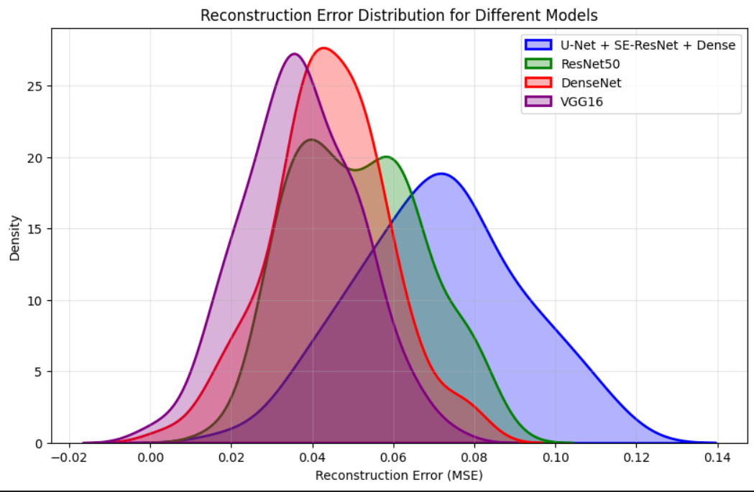
Result and Discussion
Reconstruction Error Distribution

Slide 46
Result and Discussion
Full Features vs. Segmented Features
The impact of using "Full Features" versus "Segmented Features" for Alzheimer’s detection, with a focus on how these feature sets influence reconstruction error in models, particularly autoencoders. This comparison provides insights into the optimal feature usage for identifying early signs of Alzheimer’s.
Using Full Features, which includes all available data, generally yields more stable and consistent reconstruction performance. The richness of this comprehensive feature set allows the model to capture complex structural abnormalities within MRI scans, leading to more accurate and reliable detection of Alzheimer’s-related changes in brain structure. This helps the model pick up on subtle patterns that are indicative of early-stage Alzheimer’s.

Slide 47
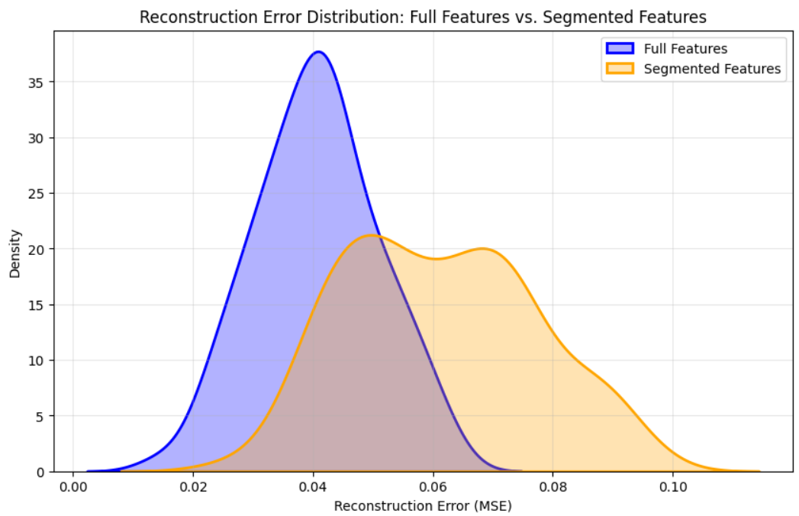
Result and Discussion
Full Features vs. Segmented Features

Slide 48
Conclusion
The Alzheimer's disease diagnosis system effectively addressed the challenges of early detection by automating the analysis of brain scans. By leveraging deep learning models and advanced image processing techniques, the system significantly improved diagnostic accuracy and efficiency. The integration of real-time processing and automated alerts enabled healthcare professionals to make quicker, more informed decisions. Additionally, the system's ability to identify early-stage Alzheimer’s patterns provides valuable support for timely interventions. While there are challenges in data quality and integration, the system demonstrated its potential to enhance the early detection and diagnosis of Alzheimer's disease, laying the foundation for future improvements and broader clinical adoption.

Slide 49
References.
A. Gupta, P. Kumar, and S. Mishra, “Efficient Alzheimer’s Detection Using Hybrid CNN-RNN Networks with MRI,” Journal of Neuroscience Methods, vol. 420, pp. 126985, Feb. 2024.
S. Foroughipoor, K. Moradi, and H. Bolhasani, “Alzheimer’s Disease Diagnosis by Deep Learning Using MRI-Based Approaches,” arXiv preprint arXiv:2310.17755, Oct. 2023.
H. Zhang, M. Liu, and C. Li, “Deep Learning Models for MRI-Based Alzheimer’s Disease Classification: A Comprehensive Review,” IEEE Access, vol. 11, pp. 10345–10358, 2023.’
M. Liu, F. Li, and L. Shen, "A multi-model deep convolutional neural network for automatic hippocampus segmentation and classification in Alzheimer's disease," NeuroImage, vol. 208, p. 116459, Mar. 2020, doi: 10.1016/j.neuroimage.2019.116459.
A. Hussain, M. Faisal, and S. Ahmad, "Classification of Alzheimer disease using DenseNet-201 based on deep transfer learning technique," PLOS ONE, vol. 15, no. 5, p. e0232399, May 2020, doi: 10.1371/journal.pone.0232399.

Slide 50
Thank You

